Slide 1

Issued: May 2012, Version 2.0
Team Activities
Identify key pests & geographies
Present at key conferences & hold workshops
Identify & contact key experts
Identify & contact local groups
Develop global & local IRM guidelines
Investigate resistance status e.g. survey
Identify, develop, validate methods
Conduct or coordinate resistance monitoring
Develop posters , presentations & educational material
Develop content for the IRAC website & eConnection

Slide 2
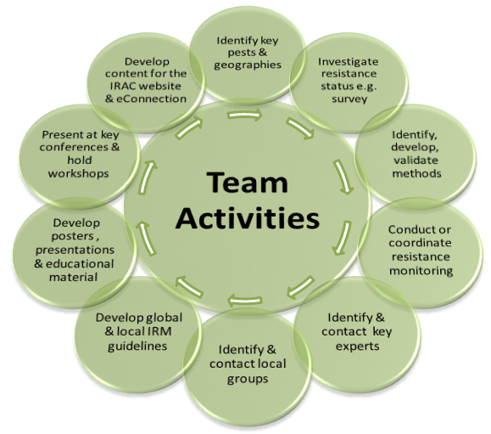
Issued: May 2012, Version 2.0
The IRAC website and eConnection is recognised as one of the main communication vehicles for IRAC. It is important to provide information such as copies of presentations, guidelines, posters and methods for posting to the site
Resistance issues relating to one country only would typically be handled by a local IRAC Country/Regional Group where this exists. If it is a global problem this could also be handled in conjunction with a global group.
Data available may be based on assumptions or anecdotal reports and therefore it is essential to validate the information by assessing if there are changes in the susceptibility of the target pest to the toxicant.
Having developed the educational and communication material it is obviously important that the WG seeks out appropriate meetings and conferences in good time so that abstracts, presentations and posters can be submitted.
Many susceptible test methods have been developed and/or validated by IRAC covering a range of pest species, life stages and chemistries. Where methods are not available a key task for the group is to develop these in conjunction with the Global Methods Group .
Another key role for IRAC is communication and education on the importance of IRM and how this is best put into practice. This can be done through the development of posters, brochures and various handouts etc
Using a standardised method comparable monitoring can be carried out by different personnel in different regions and countries to establish the extent of resistance and changes in susceptibilities.
One of the key roles for IRAC is to develop practical IRM guidelines. These need to be in line with the general IRAC principles but can be specifically tailored to the agronomic situation depending on pests, chemistries, crops and geographies involved.
It is clearly beneficial to work with established experts in the area of interest. These can be simply contacts, advisors to the group, ad hoc members or consultants.
If there are already groups working in the field of interest it makes sense to establish links and develop cooperation or joint research programs.

