Slide 1

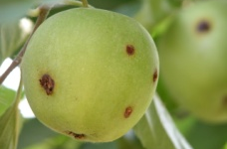
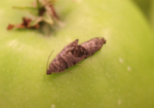
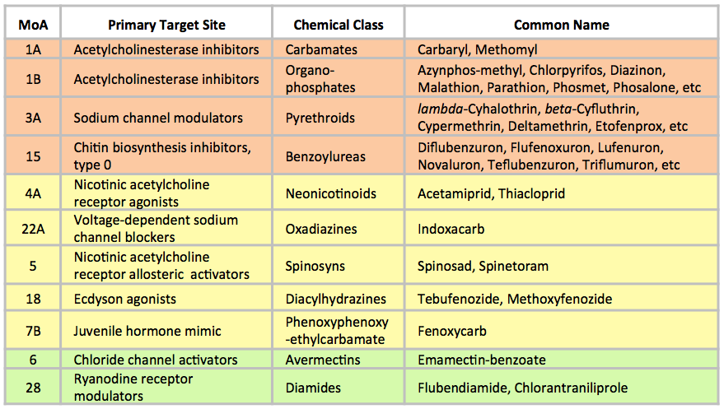
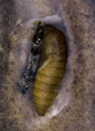


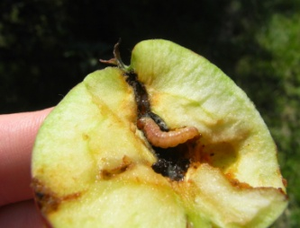
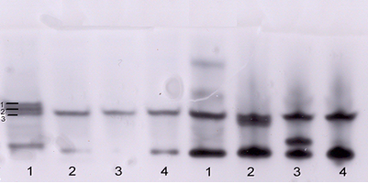

Maintaining Effective Control Strategies for
Codling Moth, Cydia pomonella
Insecticide Resistance Action Committee
www.irac-online.org
Introduction and Background
Codling Moth Resistance Mechanisms & IRM
Scenario Changes & Trends
Codling moth, Cydia pomonella L. (Lepidoptera: Tortricidae) is one of the most serious insect pest of apple and can also infest pear, crab apple, quince, walnut and other fruits. Codling moth is native to south eastern Europe and is now reported from parts of Africa, Asia, North America, South America, Australia and New Zealand.
Mechanisms
Resistance to a specific insecticide can be due to different resistance mechanisms
5th instar
Metabolic resistance (modified enzymatic activity: MFO, GST, EST)
Target-site resistance (KDR, MACE)
Reduced penetration and behavioural changes
Damage
Sensitive
OP Resistant
Electrophoretic banding pattern showing diversified esterase isoforms in OP resistant 5th instar Codling Moth larvae (Courtesy of Dr. Manicardi)
When the mechanism(s) of resistance is not charact-
erized and in order to prevent the onset of resistance
phenomena (resistance avoidance) intelligent use of MoA alternation (i.e. between consecutive codling moth generations) and other semio-chemical, bio-technical and cultural tools remains best IRM practice, since such practice will always minimize selection pressure.
Metabolic cross-resistance and its diversity: a major threat
Metabolic resistance is the most relevant type of resistance in codling moth
Different metabolic profiles (enzymatic activity) can impact different MoA/products
It can concern insecticides across different MoA, but differential response between products within the same MoA can be observed
There can be diverse patterns of metabolic resistance (differential enzymatic activity)
The diversity of the metabolic resistance found in codling moth can be significant across the different geographical areas
* Four introduced in 1997-2000, two in 2007-10
** According to IRAC MoA classification (version 7.2)
*** In terms of chemical control measures, the criteria introduced in the revision of EU Directive 91/414 may concern a significant number of the available insecticides, with an impact on sustainable control options
**** Dependent on the implementation of the other factors. Assumption is that sustainable insecticide use will continue to be possible and implemented. In this respect, increased use of non-chemical tools will play a key role
Depending on environmental conditions, codling moth has two to three generations per year. It overwinters in the pupal stage in protected areas on the trunk or in leaf litter at the base of trees. Timely, effective control is very critical because females emerge with mature eggs and can mate and lay eggs within a two-day period. Codling moth neonate larvae cause direct injury by boring into fruit which can result in significant crop losses. Upon entering the fruit larvae are well-protected and consequently, control tactics have strongly relied on chemical insecticides targeting eggs and/or newly hatched larvae. Due to the strong reliance on chemical control to manage codling moth, resistance and cross-resistance to multiple insecticide classes such as organophosphates, carbamates, chlorinated hydrocarbons and pyrethroids have been documented.
Major factors affecting the current scenario vs year 2000
Increased adoption of semio-chemicals for mating disruption
Reduction of chemical toolbox due to regulatory & food-chain pressure
Improved investigation tools for resistance detection and confirmatory assays
Bioassay and Monitoring for Resistance
Diagnosing metabolic resistance
The analysis of the enzymatic activity (MFO, GST, EST) in a codling moth population is a key element for resistance evaluation
There is a differential enzymatic activity between life-stages within the same population
In resistant strains, the enzymatic activity may not only differ in quantitative terms, but also qualitatively (e.g. esterase isoforms)
By itself, knowing the enzymatic profile of a given population does not allow to predict the field resistance nor the effectiveness of insecticide ”X”
Cross-resistance does not always concern all the insecticides with the same MoA. Azinphos-resistant codling moth may be susceptible to Chlopyrifos and vice versa.
Insecticides & MoA for Codling Moth
Life
cycle
Routine vs. validatory assays
In the last decade, large scale monitoring for field resistance mostly relied on topical application to diapausing codling moth larvae
Recent authoritative studies have confirmed their validity for IGRs, but questioned their reliability for the prediction of field resistance with some neurotoxic insecticides
By itself, significantly higher response in a routine monitoring conducted on non-target insect stage, does not allow to predict field resistance, unless validated with additional target-specific assays
Validation tests should include multiple insecticide concentrations
Bioassaying the target-stage
Resistance monitoring should be preferentially done on the target instar
For larvicidal products, ingestion bioassays on neonate larvae (F1 or F2 of the feral population) normally provide a more reliable indication of the field situation than topical application to diapausing larvae
The toolbox is not empty. Ten different modes of action are currently available for control of codling moth. Although efficacy level may vary, all of them are critical to ensure the MoA diversity needed for sustainable control.
The available toolbox should be locally qualified with the number of authorized MoA/products, the year of consistent introduction for codling moth control and the relative efficacy level provided.
Photograhs courtesy: Cydia pomonella pupae - Whitney Cranshaw, Colorado State University, Bugwood.org; Cydia pomonella eggs – Bayer CropScience
This poster is for educational purposes only. Details are accurate to the best of our knowledge but IRAC and its member companies cannot accept responsibility for how this information is used or interpreted. Advice should always be sought from local experts or advisors and health and safety recommendations followed.
Designed & produced by IRAC Codling Moth WG, Aprill 2013, Poster Ver. 2.0
For further information visit the IRAC website: www.irac-online.org

