Slide 1
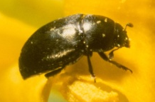

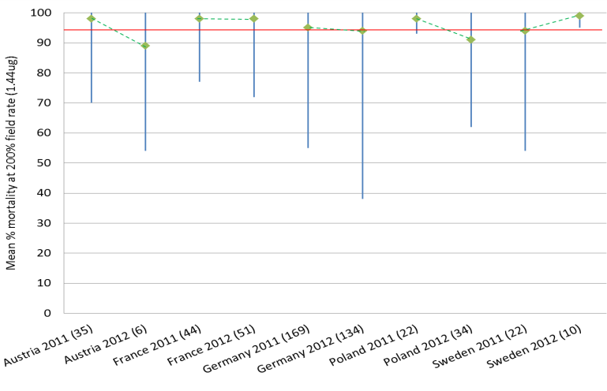

IRAC Coleopteran Working Group
Pollen Beetle Resistance Monitoring 2012
Insecticide Resistance Action Committee
www.irac-online.org
Introduction and Background
Pyrethroid resistance has been recorded in European populations of the pollen beetle (Meligethes aeneus) since 1999, when it was first reported in Eastern France. The IRAC Coleopteran Working Group brings together expertise from agrochemical companies and independent researchers in order to monitor the development and spread of resistance in pollen beetles and other coleopteran pests of oilseed rape.
Pyrethroid, neonicotinoid and organophosphate susceptibility is measured by the use of insecticide coated glass vial assays. Results of the 2012 susceptibility monitoring program are presented in this poster. More details of the methods used in this survey can be found on the IRAC website (www.irac-online.org).
Neonicotinoid susceptibility
4A
22A
1B
IRAC MoA
IRAC method # 21
1.44ug/cm² thiacloprid dose: > 95% mortality indicates susceptibility.
IRAC MoA
IRAC MoA
Indoxacarb & Organophosphate
susceptibility
IRAC method # 25 (Chlorpyrifos-ethyl)
IRAC Method # 27 (Indoxacarb)
3A
All European populations of pollen beetle tested were susceptible to both Indoxacarb and organophosphates based on the IRAC recommended discriminating dose.
IRAC MoA
Country | No. of populations tested
 | Indoxacarb | OP
Austria | 0 | 3
Czech Republic | 0 | 2
France | 0 | 9
Germany | 10 | 8
Hungary | 0 | 3
Poland | 0 | 2
United Kingdom | 0 | 1
IRAC method #11
0.075 & 0.015 ug/cm² lambda-cyhalothrin doses
Scoring system based on mortality at both doses indicates susceptibility status.
Pyrethroid resistant populations of pollen beetle dominate in all European countries surveyed.
Most pollen beetle populations tested were susceptible to neonicotinoids, but a slight reduction in the mean percentage mortality (green diamond) and an increase in the variation between populations were observed. Neonicotinoid susceptibility will continue to be monitored in the following years.
Changes in the pyrethroid susceptibility of pollen beetle populations 2007 - 2012
3A
Summary & Recommendations
In all countries surveyed, pyrethroid resistant populations of pollen beetle dominate (> 60%).
Only 7% of pollen beetle populations surveyed in Europe can be classified as pyrethroid susceptible.
In Germany and the UK the number of pyrethroid-susceptible populations continue to decline and the percentage of the most resistant populations (Resistant + Highly Resistant) continues to increase.
Large decreases in the percentage of susceptible populations of pollen beetle were also observed in the Czech Republic, Hungary and Norway when compared to 2011 levels (data not shown in poster).
A slight decrease in the mean sensitivity of pollen beetles to neonicotinoids was observed in 6 out of 9 countries surveyed, when compared to 2011 data. Monitoring of neonicotinoid susceptibility will continue in subsequent years in order to observe year to year variability (Not all data shown).
There was no evidence of changes in indoxacarb or organophosphate susceptibility observed in all countries surveyed.
In order to prevent further insecticide resistance development, it is recommended that insecticides with different modes of action are utilised in an effective resistance management program, dependent on local insecticide availability and national use guidelines. IRAC guidelines for resistance management in oilseed rape can be found on the IRAC website (www.irac-online.org).
IRAC would like to thank all of those who contributed to the survey. Participants are too numerous to name, but their contributions are very much appreciated.
IRAC MoA
Susceptibility surveys conducted between 2007 & 2012 suggest that in general pyrethroid resistant populations are continuing to increase or have stabilised at a high level (>80%) in each country.
This poster is for educational purposes only. Details are accurate to the best of our knowledge but IRAC and its member companies cannot accept responsibility for how this information is used or interpreted. Advice should always be sought from local experts or advisors and health and safety recommendations followed.
IRAC document protected by © Copyright,,Version 1.0, Designed and produced by IRAC Coleopteran Working Group, January 2013, Photographs courtesy of Syngenta Crop Protection Visit to IRAC web-site for further details at www.irac-online.org

