Slide 1


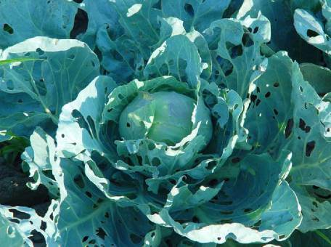
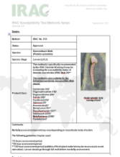
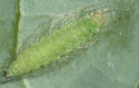
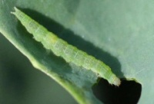
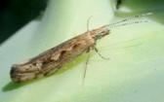
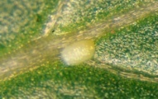
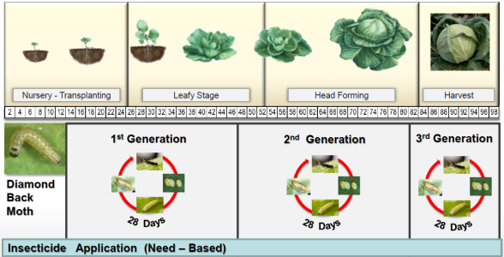

The Diamondback Moth, Plutella xylostella:
Resistance Management is Key for Sustainable Control
Insecticide Resistance Action Committee
www.irac-online.org
Introduction and Biological Background
General IRM Tactics
.
Plutella xylostella Damage in Cabbage
Diamondback moth (Plutella xylostella L.) is a highly migratory and cosmopolitan species, and is one of the most important insect pests of cruciferous crops worldwide. Globally, direct losses and control costs are estimated to be US$ 1 billion (1).
Life cycle:
In temperate regions, P. xylostella is unable to overwinter and therefore annual outbreaks are attributed to migration, but in tropical and sub-tropical regions there can be a large number of continuous generations per year (e.g. up to 21 in Taiwan) (2) .
P. xylostella is considered to be one of the most difficult pests to control. Continuous insecticide applications have been, and in many regions still are, the main tool employed for crop protection.
Cases of P. xylostella resistance to insecticides were reported in the 1950’s. Today this species shows resistance to most insecticide classes, including recently introduced compounds with new modes of action (3).
A combination of all available tools for P. xylostella management should be used to prevent the development of insecticide resistance:
  resistant varieties
  refuge crops
  biological control with natural enemies,
  e.g. Cotesia plutellae
  insecticide applications with mode of action
  rotation and windows approach
  crop hygiene
Pupae
10 days-4 weeks
7-15 days
Treated with insecticide
Not treated with insecticide
The resistance monitoring method for Plutella xylostella (IRAC Method No. 018) is available on the IRAC website and should be used to evaluate insecticide susceptibility.
Resistance Mechanisms
Chemical Control of Plutella xylostella
Several biochemical mechanisms are described as conferring resistance to insecticides in diamondback moth populations. Many of these mechanisms listed below act in concert and can provide resistance factors of 1000-fold or greater.
Enhanced metabolic detoxification mechanisms (3,4)
Insensitive acetylcholinesterase
3. Reduced Cry1C binding to target site in midgut membrane and
reduced conversion of Cry1C protoxin to toxin (5)
4. Reduced penetration (6,7)
5. Target-site resistance (7-10)
.
Larvae
Adult
Select insecticides based on known local effectiveness and selectivity
Rotate insecticides by mode of action group, using a window approach
Use only insecticides registered for diamondback moth control
Always follow the directions for use on the label of each product
5-10 days
MoA | Primary Site of Action | Chemical Sub-group or Exemplifying Active
1 | Acetylcholinesterase inhibitors | 1A:Carbamates 1B:Organophosphates
2 | GABA-gated Cl channel antagonists | 2B: Phenylpyrazoles (Fiproles)
3 | Sodium channel modulators | 3A: Pyrethroids, Pyrethrins
4 | Nicotinic acetylcholine receptor agonists | 4A: Neonicotinoids
5 | Nicotinic acetylcholine receptor allosteric activators | Spinosyns
6 | Chloride channel activators | Avermectins, Milbemycins
11 | Microbial disruptors of insect midgut membranes and derived toxins | Bacillus thuringiensis var. kurstaki
13 | Uncouplers of oxidative phosphorylation via disruption of the proton gradient | Pyrrols
15 | Inhibitors of chitin biosynthesis, type 0 | Benzoylureas
18 | Ecdysone receptor agonists | Diacylhydrazines
21 | Mitochondrial complex I electron transport inhibitors | 21A: Tolfenpyrad
22 | Voltage-dependent Na channel blockers | 22A: Indoxacarb 22B: Metaflumizone
28 | Ryanodine receptor modulators | Diamides
UN | Compounds of unknown/uncertain MoA | Azadirachtin, Pyridalyl
Eggs
Resistance Mechanisms
Resistance Management (example)
The figure below shows a resistance management strategy developed for use in Brassica crops in the Philippines.
References
Gryzwacz, D., A. Rossbach, D. Russell, R. Srinivasan, A.M. Shelton. 2010. Crop Protection 29 (1): 68-79
Chapman, J.W., D.R. Reynolds, A.D. Smith, J.R. Riley, D.E. Pedgley, I.P. Woiwod. 2002. Ecol. Entomol. 27: 641-650
Zhao, J.Z., L.H. Collins, X.Y. Li, R.F.L Mau, G.D. Thompson et al. 2006. J. Econ. Entomol. 99: 176-181
Hung, C.F., C.H. Kao. C.C. Liu, J.G. Lin, and C.N. Sun. 1990. J.Econ.Entomol. 83: 361-365
Liu, Y.B., B.E. Tabashnik, L. Mason, B. Escriche, and J. Ferre. 2000. J. Econ. Entomol. 93: 1-6
Noppun, V., Saito, T., Miyata, T., 1989. Pestic. Biochem. Physiol. 33, 83-87.
Li, A., Y.Yang, S. Wu, C. Li., and Y. Wu. 2006. J.Econ.Entomol. 99: 914-919
Baxter, S.W., Chen, M., Dawson, A., Zhao, J.Z., Vogel, H., Shelton, A.M., Heckel, D.G., Jiggins, C.D., 2010.. PloS Genetics 6, e1000802
Sonoda, S., 2010. Pest. Manag. Sci. 66, 572-575
Troczka, B., C.T. Zimmer, J. Elias, C. Schorn, C. Bass, T.G.E. Davies, L.M. Field, M.S. Williamson, R. Slater, R. Nauen. 2012. Insect Biochem Mol Biol 42, 873-880
.
Option 1
(preferred)
MoA A
MoA B
MoA C
Option 2
MoA A
MoA B
MoA A
This poster is for educational purposes only. Details are accurate to the best of our knowledge but IRAC and its member companies cannot accept responsibility
for how this information is used or interpreted. Advice should always be sought from local experts or advisors and health and safety recommendations followed.
Designed by IRAC Lepidoptera WG, March 2013, Poster Ver. 3.1 For further information visit the IRAC website: www.irac-online.org
Photograhs courtesy : Russ Ottens, University of Georgia, Whitney Cranshaw, Colorado State University; Bugwood.org BayerCrop Science
IRAC document protected by © Copyright

