Slide 1

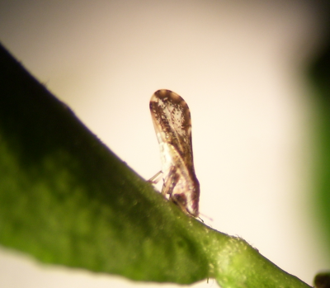
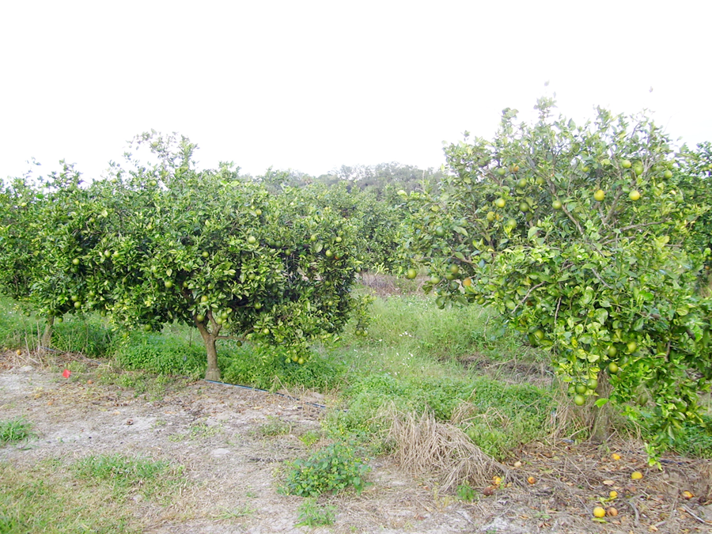
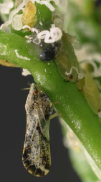

The Asian citrus psyllid, Diaphorina citri:
‘Insect Resistance Management’ the Base for a Successful IPM Program
Insecticide Resistance Action Committee
www.irac-online.org
Introduction and Biology
Resistance to Insecticides
Management Plan Example
The Asian citrus psyllid (ACP), Diaphorina citri Kuwayama (Fig. 1a.), is the insect vector associated with the bacteria Candidatus Liberobacter asiaticus and C. L. americanus. These bacteria are suspected to be the causal agents of Huanglongbing (HLB) in Asia and America. Trees infected with the bacterial pathogen begin to show symptoms such as early fruit drop and mottled leaves anywhere from 5 months to 3 years after infection. Even during this asymptomatic period, plants can also be source of inoculum, hence the need to manage the vector even if the trees are not showing symptoms (Fig. 1b). Once the trees are infected, the production rapidly declines rendering the infected trees unproductive in a few years.
Citrus psyllids lay their eggs on the inner-side of unfolding leaves which protect the eggs and early nymphs from adequate insecticide contact, rendering applications of non-systemic insecticides inefficient to manage nymphs. The psyllid nymphal stage has 5 instars taking between 15 and 47 days to become adults depending on environmental conditions. Nymphs acquire the bacteria and the adults vector the disease to uninfected plants and to plants that are already infected, increasing the bacterial titer in already diseased plants. Adults are considered to be the preferred target for foliar insecticide applications since they vector the bacteria. Systemic soil insecticide target nymphs and adults for the first 2 years after planting, after that period, threes are too big for the current chemistries to be effective.
Various levels of insecticide susceptibility have been reported in Florida, USA (Table 1). Although the resistance ratios are not high in comparison to those of other pests, it is important to be vigilant to prevent the onset of resistance for this pest. The results in table 1 are correlated with to elevated levels of detoxifying enzymes in both adults and nymphs collected in the field. However, ACP carrying HLB were shown to be more senstivie to insecticides than non-infected psyllids.
Figure 2: Management plan and opportunities for MoA rotation used for citrus psyllid based on plant phenology. The rotation uses various MoA which are registered and labeled for control of citrus psyllids. The rotations and number of MoA might vary according to the number of products registered in each country.
Growing
  Adults + Nymphs
    Selective MoA
    Use thresholds
    Protect natural enemies
Pre-bloom/Dormant
  Adults
    Broad spectrum MoA
    Area wide
Growing Season
Dormant Season
Harvest Season
Table 1: Highest Resistance Fractor 50 values observed on various wild population of D. citri in Florida in 2010. (Tiwari et al. 2011)
Bloom Season
 | imidacloprid | chlorpyrifos | thiamethoxam | malathion | carbaryl | spinetoram
RR50 adults | 35X | 18X | 15X | 5X | 3X | 2X
RR50 nymphs | 4X | 3X | No tested | No tested | 3X | 6X
Harvest
Adults + Nymphs
    Selective MoA
    Short PHI and REI
    Protect natural enemies
    Application based on thresholds
Bloom
  Adults + Nymphs
    Selective MoA
    Bees present
    Augmentation of natural enemies
Integrated ACP Management Guidelines
Protect nursery plants under netting and use only HLB free certified stock.
Transport infected nursery stock according to government regulations.
Protect young and non-bearing trees with soil applied systemic insecticides. In older trees, soil applied systemic insecticides may not satisfactorily work on the pest.
Rotate soil-applied insecticides with foliar sprays of other modes of action. Rotation of different modes of action is key to resistance management.
Management of adults during dormant season is key to maintain low populations for the rest of the year.
Use locally defined monitoring methods and intervention thresholds to make spray decisions. Notify to manufacturers any product performance failures immediately.
Use and protection of bio-control agents is encouraged as part of the IPM programs and to reduce the risk of insecticide resistance development.
Table2: Modes of action registered for ACP management. Pest and Resistance management should be based on an appropriate rotation of these MoA
Diaphorina citri Adult and nymphs
Picture : ME Rogers U. of Florida
Picture: HA Arevalo. U of Florida
Modes of action registered for ACP management
1 A&B: AChE Inhibitors | 4: nAChR agonist | 15: Inhibitors of chitin biosynthesis type 0 | NR: Horticultural oils
2B: GABA antagonists | 5: nAChR allosteric activators | 18: Ecdysone receptor agonist
3: Na^{[+]} Chanel modulator | 6: Cl ^{[-]} channel activator | 23: Inhibitor of aCoA carboxylase
Fig. 1: (a.) Adult of D. citri feeding on a young orange leave. (b.) HLB infected trees: asymptomatic (left) and symptomatic (right). Notice fruits on the ground, leaf coloration, and dieback are more prominent on the symptomatic plant
Relevant Literature
Arevalo. H.A., A.B. Fraulo, G. Snyder, and P. A. Stansly. 2011. Citrus Greening Bibliographical Database. University of Florida. http://swfrec.ifas.ufl.edu/entomology/extension/hlb/
Rogers, M.E., P.A. Stansly, L.L. Stelinski. 2012. 2012 Florida Citrus Pest Management Guide: Asian Citrus Psyllid and Citrus Leaf Miner . IFAS –University of Florida . ENY-734 . http://edis.ifas.ufl.edu/in686
*Tiwari, S., R.S. Mann, M.E. Rogers, L.L. Stelinski. 2011. Insecticide Resistance in Field Populations of Asian Citrus Psillid in Florida. Pest Management Science 67: 1258-1268
* Provisional method used by IRAC to evaluate insecticide susceptibility by Asian citrus psyllid
This poster is for educational purposes only. Details are accurate to the best of our knowledge but IRAC and its member companies cannot accept responsibility for how this information is used or interpreted. Advice should always be sought from local experts or advisors and health and safety recommendations followed.
Designed & produced by the IRAC Sucking Pest Team, Jan .2013, Poster Ver.1.0. Photographs courtesy of ME Rogers (University of Florida), HA Arevalo (U. of Florida now with BASF Corp). IRAC document protected by © Copyright

