Slide 1
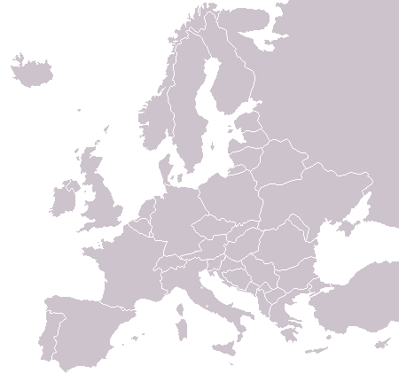

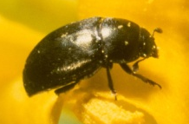
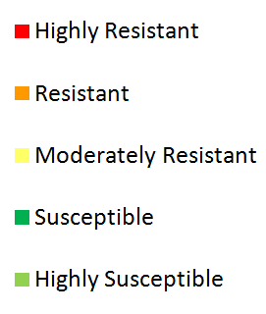

IRAC Oilseed Rape Working Group
Pollen Beetle Resistance Monitoring 2010
Insecticide Resistance Action Committee
www.irac-online.org
Introduction and Background
Pyrethroid resistance has been recorded in European populations of the pollen beetle (Meligethes aeneus) since 1999, when it was first reported in Eastern France. The IRAC Oilseed Rape Working Group brings together expertise from agrochemical companies and independent researchers in order to monitor the development and spread of pyrethroid resistance in pollen beetles.
Pyrethroid susceptibility is measured by the use of an insecticide coated glass vial assay. This results of the 2010 susceptibility monitoring program are presented in this poster. More details of the method utilised in this survey can be found on the IRAC website (www.irac-online.org).
2010 Susceptibility Monitoring
The IRAC Pollen Beetle Working Group would like to thank to all who contributed to the survey ☺
Charts indicate proportion of populations belonging to each pyrethroid susceptibility category within each country. The number assigned to each chart indicates the number of populations utilised in each country survey.
6
Summary & Recommendations
Pyrethroid resistant populations of pollen beetle dominate in western mainland European countries (France, Germany, Denmark, Switzerland) as well as the Czech Republic, Lithuania and Poland.
Large increases (>10%) in the frequency of resistant populations of pollen beetle are observed in Latvia, Lithuania, Finland, Hungary and the UK as resistant beetles spread North and North-East.
Small increases in the proportion of total susceptible beetles are observed in Poland and the Czech Republic. It is speculated that this may be due to a reduction on the reliance e of pyrethroid insecticides in these countries, however this may only be a reflection of a small sample number.
Only Romanian and Ukrainian populations of pollen beetles have remained fully susceptible to pyrethroids in this and previous surveys.
Susceptibility surveys conducted between 2007 and 2010 suggest that in general pyrethroid resistant populations are continuing to increase in Europe and spread into the North and East.
In order to prevent further insecticide resistance development, it is recommended that insecticides with different modes of action are utilised in a effective resistance management program, dependant on local insecticide availability and national use guidelines. IRAC guidelines for resistance management in oilseed rape can be found on the IRAC web-site.
4
12
32
7
20
2
30
271
21
4
20
Changes in the pyrethroid susceptibility of pollen beetle populations 2007 - 2010
129
120
 | % of total number of populations falling into susceptibility catagory
 | Highly susceptible | Susceptible | Moderately resistant | Resistant | Highly Resistant | % change in susceptible beetles* 2009 to 2010
Czech Republic (n=21) | 0 | 10 | 38 | 33 | 19 | + 5
Denmark (n=7) | 0 | 0 | 14 | 86 | 0 | 0
Finland (n=6) | 0 | 50 | 17 | 33 | 0 | - 10
France (n=129) | 0 | 10 | 19 | 63 | 9 | - 2
Germany (n=271) | 1 | 8 | 16 | 43 | 31 | - 2
Latvia (n=12) | 17 | 25 | 58 | 0 | 0 | - 58
Lithuania (n=32) | 0 | 3 | 28 | 69 | 0 | 16
Poland (n=20) | 0 | 10 | 20 | 55 | 15 | + 3
Romania (n=20) | 100 | 0 | 0 | 0 | 0 | 0
Sweden (n=4) | 0 | 0 | 75 | 25 | 0 | 8
Switzerland (n=120) | 0 | 2 | 10 | 52 | 37 | 2
UK (N=30) | 27 | 13 | 13 | 30 | 17 | 14
Ukraine (n=2) | 100 | 0 | 0 | 0 | 0 | NA
Hungary (n=4) | 50 | 0 | 50 | 0 | 0 | - 17
* Combined total of highly susceptible and susceptible categories
This poster is for educational purposes only. Details are accurate to the best of our knowledge but IRAC and its member companies cannot accept responsibility for how this information is used or interpreted. Advice should always be sought from local experts or advisors and health and safety recommendations followed.
Version 1.0, Designed and produced by IRAC Oilseed Rape Working Group, January 2011, Photographs courtesy of Syngenta Crop Protection Visit to IRAC web-site for ffurther details at www.irac-online.org
IRAC document protected by © Copyright

