Slide 1
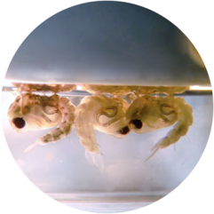
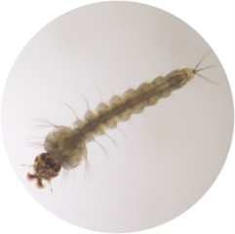
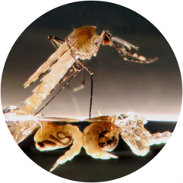
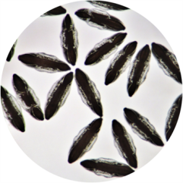
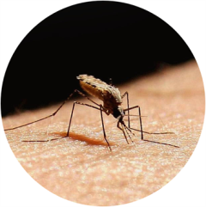

Monitoring Methods
CDC Bottle Assay
Insecticide Resistance Management

Slide 2
Monitoring Methods (Adult Mosquitoes) – CDC Bottle Assay
CDC Bottle Test Kit - Adult Mosquitoes:
The bottle bioassay method is a tactical surveillance tool for detecting and characterising changes in susceptibility to insecticides in vector populations. The bioassay uses 250 ml glass bottles. The internal surfaces of the bottle are coated with the desired insecticide diluted in acetone or ethanol. Once the solvent has evaporated, between 10 and 20 adult mosquitoes are aspirated into the bottles and sealed using the lid. Assessments of knockdown or mortality are made at 10 minute intervals. Knockdown or mortality is then plotted against time. Changes in the slope of this graph over time are indicative of changes in the susceptibility of the mosquito population.
250ml Glass Bottles
KD or mortality
Time
An appropriate diagnostic dose should be calculated at the start of the monitoring programme using an insecticide rate range study. To guide this, the following doses are suggested: cyano-pyrethroids, e.g. deltamethrin = 25 µg/bottle and non-cyano-pyrethroids, e.g. permethrin = 43 µg/bottle.
For further details on this method see: www.cdc.gov/ncidod/wbt/resistance/assay/bottle/index.htm. The CDC will furnish, at no cost, premeasured amounts of WHOPES approved IRS and LLIN insecticides, sufficient to conduct approximately 100 bottle assays for each insecticide. Recipient is responsible for approval to import these insecticides into their country. Contact Dr. William Brogdon (wgb1@cdc.gov) for additional information or to request shipment of insecticides.
15

