Slide 1
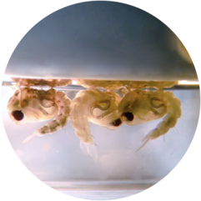
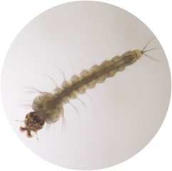
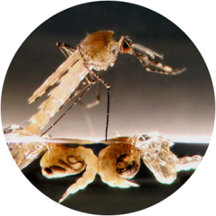
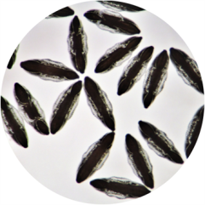
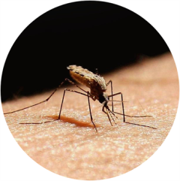

Monitoring Methods WHO Test Kit
Insecticide Resistance Management

Slide 2
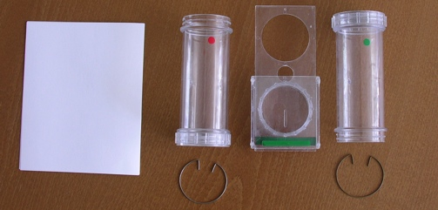
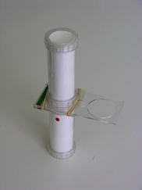
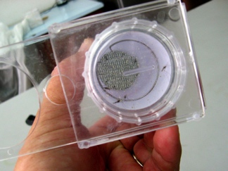
Monitoring Methods (Adult Mosquitoes) – WHO Test Kit
There are various bioassay, biochemical and molecular methods that can be used to test and monitor resistance development. These can be used together to maximize outputs from monitoring in a region.
WHO Test Kit - Adult mosquitoes:
The principle of this test is to expose mosquitoes for a given time in a specially designed plastic tube lined with a filter paper treated with a standard concentration of insecticide. The dose rate on the paper (diagnostic concentration) is 2x the lethal dose estimated to kill 100 % of mosquitoes of a susceptible strain. Mosquitoes are generally exposed to the treated papers for one hour and mosquito mortality is assessed after 24 hours. This approach has been designed to avoid spurious reports of resistance in the field where none may exist. The kit and papers can be purchased with full instructions on their use. Supplier details can be found at: www.who.int/whopes/resistance/en/
A
B
C
Disassembled WHO Cylinder Test Kit – Adult Mosquitoes (A). The green dot indicates the holding portion of the cylinder, while the red dot indicates the exposure portion of the cylinder. Movement of adult mosquitoes is accomplished by the movable gate that separates both halves of the assembly. An assembled WHO cylinder test kit (B) can be observed, and adult mosquitoes are indicated by black arrows (C) resting on the interior side walls of the treated papers that line the walls of the test kit.
12

Slide 3
Monitoring Methods (Adult Mosquitoes) – WHO Test Kit
WHO Test Kit - Adult mosquitoes - Interpreting results:
The 24 hour mortality is expressed as a percentage. If the mortality in the control groups is over 5% but less than 20%, a correction of mortality is made by applying Abbot’s formula.
If the control mortality is > 20% the test results are discarded and the test will need to be repeated. The average mortality obtained at the same concentration is calculated in at least three replicates.
Results are interpreted as follows:
When < 95 % mortality occurs in replicated tests that have been conducted under optimum conditions with sample size of > 100 mosquitoes, then resistance within the tested population can be strongly suspected.
100 x (% test mortality - % control mortality)
100 - % control mortality
98 – 100% mortality | Susceptible population
80 – 97% mortality | Resistant individuals within the population suspected, but verification/confirmation required
<80% mortality | Resistant individuals within the population present
13

Slide 4
Monitoring Methods (Mosquito Larvae) – WHO Test Kit
WHO Test Kit – Larvicides (Chemical):
This methodology aims to determine resistance in mosquito larvae based on diagnostic concentrations developed from dose response lines against susceptible species. The test assesses the resistance to the insecticide used, but can also be used to determine if cross-resistance is present.
The technique requires the testing of 3rd and 4th instar larvae collected from the wild. A wide range of concentrations is used to start with, so that an approximate dose response can be calculated. Then a narrower range of 4-5 concentrations yielding 10% and 95% mortality in 24 hour or 48 hours are used to determine LC₅₀ and LC₉₀ values.
WHO Test Kit – Larvicides (Insect Growth Regulators)
Different tests are conducted with IGRs as mortality may be slower or not take place until the pupal stage. Therefore, mortality is assessed every other day or every third day until the completion of adult emergence. The result is expressed in terms of the percentage of larvae that do not develop into successfully emerging adults, or adult emergence inhibition.
Bacterial larvicides
Larvicides such as Bti* or Bs* may be tested in the laboratory to determine resistance with the same methodology as for chemical larvicides, except in the preparation of stock solution.
Full details of the tests be found at: www.who.int/whopes/guidelines/en/
* Bti: Bacillus thuringiensis var. Israeliensis, Bs: Bacillus sphaericus.
14

