Slide 1
Are there any transferable lessons for Insecticide Resistance Management between Agriculture and Vector Control?

Slide 2
IRAC?
Insecticide Resistance Action Committee (IRAC)
  Specialist technical group of the agrochemical industry association CropLife International
  Formed in 1984
  Provides a coordinated industry response to the development of resistance in insect and mite pests
“Resistance Management for Sustainable Agriculture and Improved Public Health”

Slide 3
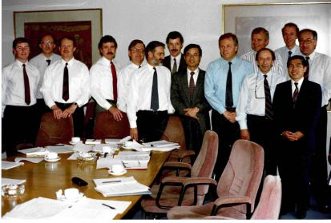

IRAC
1984
2013

Slide 4
Insecticide Resistance
1887
Scale insects “resistant” to kerosene
1914
Insects resistant to sulphur sprays
1948
House flies resistant to DDT
2012
574 species of “resistant” insects
338 insecticides

Slide 5
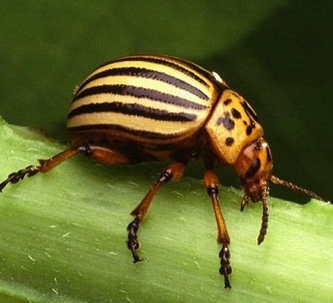
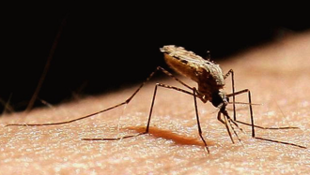
Crop Protection vs Vector Control
Similarities…
The main aim is to stop the insect pests from feeding

Slide 6


Crop Protection vs Vector Control
Similarities…
The mechanism of selection is fundamentally the same
Resistance rare
Resistance increasing
Survivors reproduce
Exposure to insecticide
Further exposure to the same class of insecticide
Resistance development
Majority of population resistant
Resistance common
Survivors reproduce
Further exposure to the same class of insecticide
Key: Resistant
Susceptible

Slide 7
Insecticide Resistance Management
Similarities:
  Primary aim is to remove, or reduce, the selection pressure for the genes that result in “resistant” phenotypes.
Differences:
  insect control requirements
  available insecticidal tools
  decision making processes used to decide upon the intervention

Slide 8
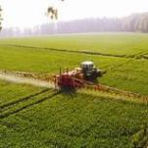
Insect control requirements
Agriculture
  Yield and quality key
  Potentially many pest spp. in a crop
  Different pests during crop cycle
  Multiple/rapid insecticide applications possible
  Crop rotation

Slide 9
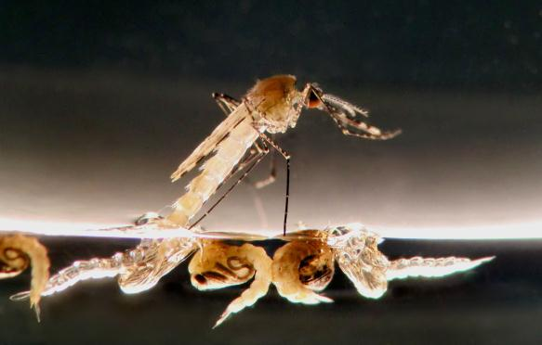
Insect control requirements
Vector Control
  Reduction in malaria burden is key
  Limited species targeted
  Insecticide application logistically challenging
  Multiple generations exposed to same insecticide

Slide 10
Available insecticidal tools
Agrochemical plus non-crop market ca. $54 Billion
Vector Control market <$1 Billion
Source: Phillips McDougall report 2013.

Slide 11
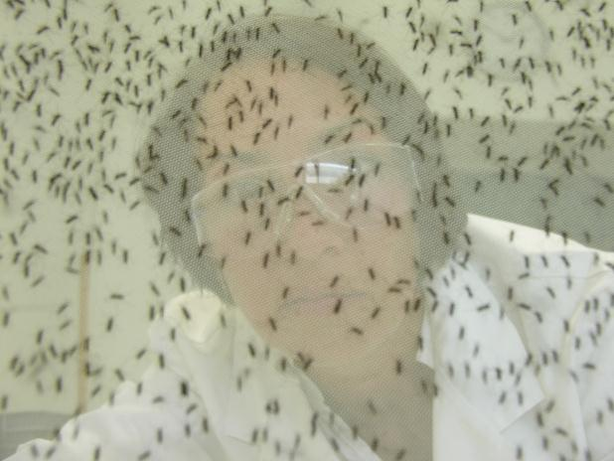
Available insecticidal tools
Relatively small size of Vector Control market has made investment in novel insecticide development historically unattractive
Regulatory pressure on broad spectrum and persistent insecticides limits opportunity for insecticides with both agricultural and vector control utility
  No novel commercialised MoA for vector control since pyrethroids

Slide 12
Available insecticidal tools
Success rate
Cost
Number of US & EU Research-based Companies
Success rate = number of cpds that need to be screened for each product found
Data from GT Brooks 1974, RL Metcalf 1980, W. Klassen 1995 Philips McDougal, 2003, CropLife 2011

Slide 13
Decision making processes
Crop Protection:
Insecticide purchase based on cost benefit analysis, return on investment
Many growers, each including a variety of factors in their analysis
  Making room for many different products
  → Competitive market
Incentivises innovation and product development

Slide 14
Decision making processes
Crop Protection:
Decision to implement IRM also a cost benefit analysis
  Looking at the financial implications of insecticide resistance development on future crops

Slide 15
Decision making processes
Vector Control:
Insecticide product choice based on analysis of impact, and how much money is available, not how much can be made
influenced by third parties, donors, etc.
Often tender based, smaller number of vendors and purchasers
  Encourages similarity in products
  → Leads to less than perfect market
Disincentives innovation and product development

Slide 16
Decision making processes
Vector Control:
Decisions to implement IRM are complicated by the need to protect the greatest proportion of the human population from vector borne disease
  This short term imperative is not necessarily compatible with longer term IRM.

Slide 17
Lessons…
Resistance can, and will, eventually develop to any insecticide
Cases of Resistance During the First 14 Years Following Launch
Deltamethrin
Imidacloprid
Abamectin
Permethrin
Spinosad
Profenofos
Chlorpyrifos
Chlorantraniliprole

Slide 18

Lessons…
  There is still an agricultural insecticide market
  Whilst IRM has had limited success in preventing resistance development, it is successful at managing resistance once it has arisen in a pest population and prolonging the useful life of that insecticide class

Slide 19
Lessons…
How has the effective use of insecticides been sustained, despite insecticide resistance development in agriculture?
  Integrated Pest Management (IPM)
  IRM built into product label
  rotation of insecticide classes, etc.
  “spray windows”
  untreated refugia
  development and introduction of novel insecticide classes

Slide 20
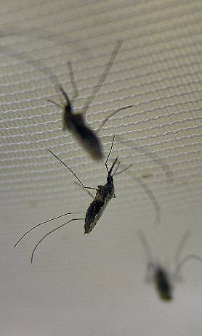
Lessons…
Crop Protection has no silver bullet for Vector Control
  But there are lessons that can be learnt from their comparison…

Slide 21
Lessons…
Integrated approach:
  Integrated Vector Management (IVM) is key, both to Vector Control, and IRM
    Any activities that reduce the adult mosquito population, without recourse to adulticides, will help to reduce the selection pressure for insecticide resistance development

Slide 22
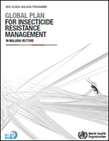
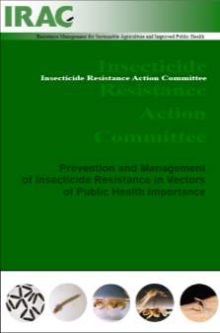

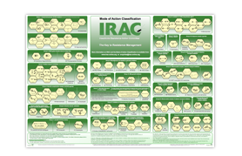
Lessons…
Several sources of information on best practice IRM in Vector Control
  Mixtures
  Rotations
  Mosaics
  Etc.
  Monitoring
  Source reduction
  Education and training

Slide 23
Lessons…
Unlike Crop Protection, the Vector Control adulticide market is not conducive to product innovation →fewer products for IRM
  Relatively small size, vs cost of development of novel mosquito adulticide
  Tender business encourages development of products that “satisfy” not “excel”
  Entrance to regulated market through “equivalence” destroys motivation to invest in innovation

Slide 24
Lessons…
An advantage for IRM in Vector Control?
  A smaller pool of Vector Control programmes and a supra-regulatory quality assurance system
  A greater appreciation of the value of insecticide susceptibility, through the dearth of novel insecticides
  → Easier to communicate the value and principles of IRM
    Encourage a longer term view

Slide 25
Lessons…
In Crop Protection, it can be challenging to incentivise all insecticide users to follow the principles of IRM
  Historic pipeline of resistance busting insecticides
  Cheap old generic products
  Many small growers
    Encourages short term view
“Spray and pray”

Slide 26
Lessons…
Resistance will eventually develop
  Continual use of insecticides from a mode of action class where susceptibility is declining, is selecting for eventual product failure
  Monitoring and early implementation of IRM can help to delay resistance development and prolong the useful life of insecticidal modes of action
  Better still, have an IRM programme in place when a novel insecticide is first launched or used

Slide 27
Lessons…
Susceptibility a “common good”
  Susceptibility of a mosquito population to an insecticide is a “common good”; with financial and utilitarian value, freely available to all
  Every time an insecticide application is made, without consideration of IRM, a tiny part of “susceptibility” is used up. Once its gone, it can’t be retrieved, which reduces the future benefits from Vector Control with that insecticide
  IRM should therefore be considered when planning all Vector Control programmes, to minimise the amount of lost “susceptibility”

Slide 28
Summary
Vector borne disease free environment
Sustainable Malaria Management - Eradication
Integrated Vector Management
Insecticide Resistance Management

Slide 29
Conclusions
To deliver more tools for IRM need to incentivise innovation – pull as well as push
Integrate IRM into all Vector Control programmes (IVM)
Have an IRM strategy in place before novel insecticides are introduced

Slide 30




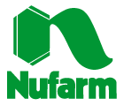




Thank you for your attention
With thanks to the IRAC Public Health Team
IRAC Executive Member Companies

