Slide 1

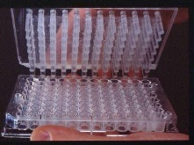
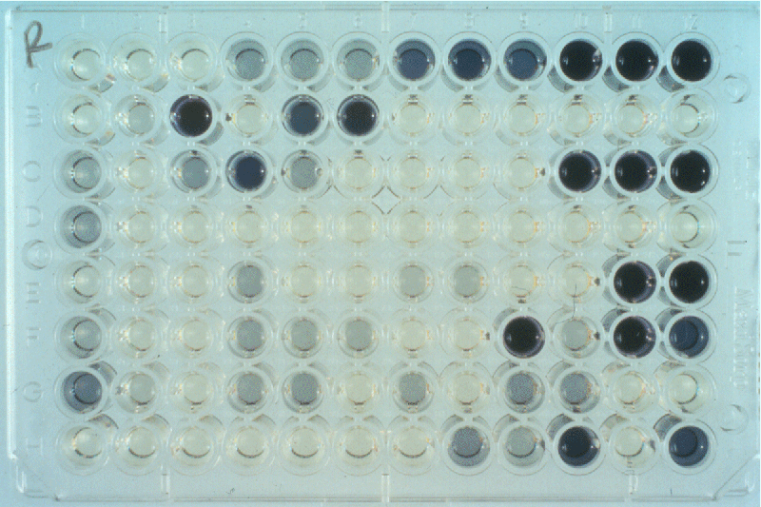
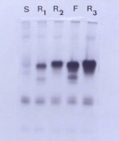
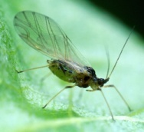

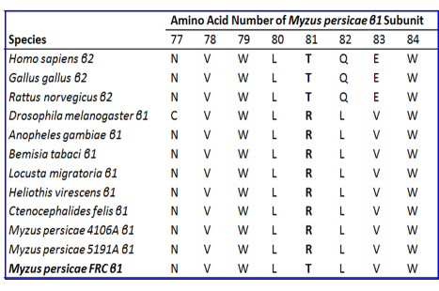
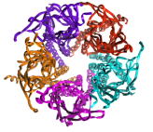

Major mechanisms of insecticide resistance in green peach aphid Myzus persicae Sulzer
Insecticide Resistance Action Committee
www.irac-online.org
Introduction and biological background
Green peach aphid Myzus persicae (Sulzer) is a cosmopolitan and polyphagous pest. Primary hosts are predominantly Prunus persica (including var. nectarina), while secondary hosts include plants in 40 different plant families as well as economically important crops. In addition to direct plant damage, M. persicae is a highly efficient vector of over 100 different plant viruses.
First reports of insecticide resistance in M. persicae date to 1955. Four major resistance mechanisms presented here in short have been detected to date. Altogether, they particularly confer resistance of M. persicae to carbamates, organophosphates (OP´s), pyrethroids and neonicotinoids. Whereas no validated field resistance reports are known for MoA groups 9, 23 and 28. Combined use of resistance detection techniques against field populations provides farmers with information on possible problems with certain insecticides and helps in better management strategies.
2. MACE (modified acetylcholinesterase)
4. kdr (knock-down resistance)
.
carbamates and OP´s act by inhibiting acetylcholinesterase (AChE)
substitution of a serine at position 431 by a phenylalanine in ACE2
leads to target site resistance to dimethylcarbamates, e.g. pirimicarb
the resistance mechanism is genetically dominant
resistant aphids are identified with microplate AChE inhibition assays
pyrethroid insecticides cause knock-down resistance (“kdr” or “super
kdr”), conferred by changes in a voltage-gated sodium channel protein
voltage-gated sodium channel in the central nervous system has 4
transmembrane domains with 6 subunits each
substitution of leucine to phenylalanine results in kdr genotypes, a
mutation found in many pyrethroid resistant pest species
kdr resistant individuals usually also show high levels of E4
esterase (which contributes to pyrethroid resistance)
overall effects in M. persicae is a loss in fitness
Inhibition of acetylcholinesterase by pirimicarb in different strains of aphids (strain Roznava is homozygously susceptible; strains H7-03 and T02 are heterozygously and homozygously resistant, resp.)
Super-kdr
kdr
1. Enhanced expression of esterases
esterases are soluble enzymes hydrolysing ester bonds
carboxylesterases (E4 and EF4) sequester or degrade esters of
organophosphate and carbamate insecticides before they reach their
target site
overproduction of named carboxylesterases causes resistance of M.
persicae to organophosphates, carbamates, but less to pyrethroids
detection is done by artificial model substrates or by ELISA
simple handling and quick determination are further advantages
3. nAChR target-site resistance
Resistance Management Guidelines
compounds should be used according to the label recommendations
rotating compounds from different mode of action groups is strongly
recommended
non-chemical control measures should be incorporated (IPM)
.
a single point mutation, R81T in the M. persicae ß1-subunit (loop D) of the nAChR confers neonicotinoid resistance
the R81T mutation confers a loss of direct electrostatic interactions of the electronegative pharmacophore with the basic arginine residue at this key position within loop D
Homogenizer ELISA detection of E4 Electrophoresis
.
References
Jeschke P & Nauen R (2008) Neonicotinoids: From zero to hero in insecticide chemistry. Pest Manag Sci 64, 1084
Devonshire AL (1998) The evolution of insecticide resistance in the peach-potato aphid, Myzus persicae. Phil. Trans. R. Soc. Lond. B 353, 1677.
Foster SP et al., (2008) Correlated responses to neonicotinoid insecticides in clones of the peach-potato aphid, Myzus persicae (Hemiptera: Aphididae) Pest Manag Sci 64, 1111.
Nabeshima T et al. (2003) An amino acid substitution on the second acetylcholinesterase in pirimicarb-resistant strains of the peach-potato aphid, Myzus persicae. Biochem Biophys Res Comm 307, 15.
Nauen R & Denholm I (2005) Resistance of insect pests to neonicotinoid insecticides: Current status and future prospects. Arch Insect Biochem Physiol 58, 200.
Fontaine S et al. (2011) Uncommon associations in target resistance among French populations of Myzus persicae from oilseed rape crops. Pest Manag Sci 67, 881
Bass C et al. Mutation of a nicotinic acetylcholine receptor b subunit is associated with resistance to neonicotinoid insecticides in the aphid Myzus persicae. BMC Neuroscience 12, 51
This poster is for educational purposes only. Details are accurate to the best of our knowledge but IRAC and its member companies cannot accept responsibility
for how this information is used or interpreted. Advice should always be sought from local experts or advisors and health and safety recommendations followed.
IRAC document protected by © Copyright
Designed & produced by IRAC Sucking Pest WG March 2014, Poster Ver. 9
For further information visit the IRAC website: www.irac-online.org Photographs courtesy of USDA and Rothamsted Research

