Slide 1

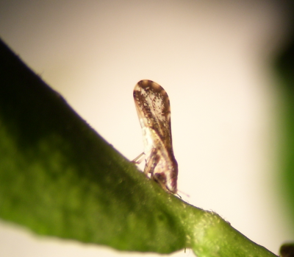
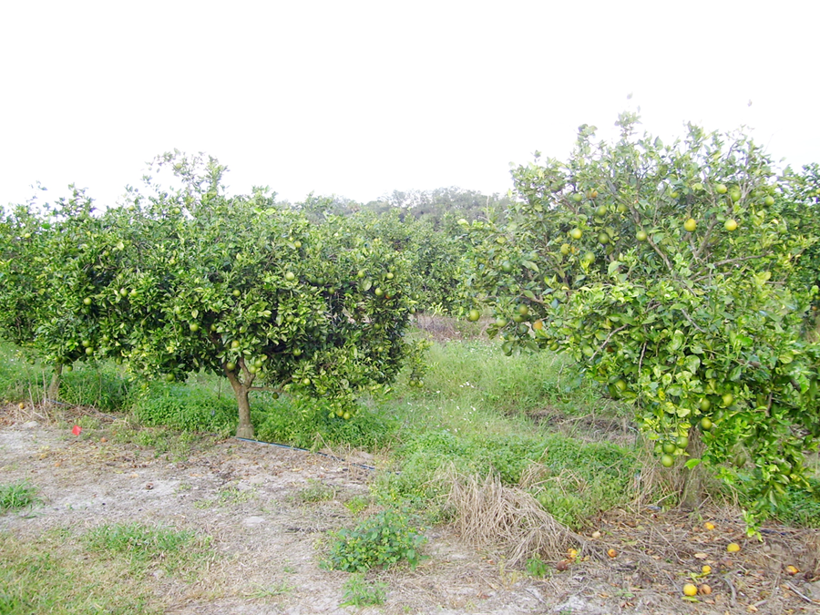
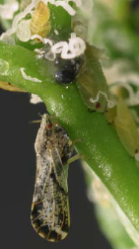

The Asian citrus psyllid, Diaphorina citri:
‘Insecticide Resistance Management’ is the Basis of a Successful IPM Program
Insecticide Resistance Action Committee
www.irac-online.org
Introduction and Biology
Resistance to Insecticides
Management Plan Example
The Asian citrus psyllid (ACP), Diaphorina citri Kuwayama (Fig. 1a.), is the insect vector associated with the bacteria Candidatus Liberobacter asiaticus and C. L. americanus. These bacteria are suspected to be the causal agents of Huanglongbing (HLB) in Asia and America. Trees infected with the bacterial pathogen begin to show symptoms such as early fruit drop and mottled leaves anywhere from 5 months to 3 years after infection. Even during this asymptomatic period, plants can also be source of inoculum, hence the need to manage the vector even if the trees are not showing symptoms (Fig. 1b). Once the trees are infected, their production rapidly declines rendering the infected trees unproductive in a few years.
Various levels of insecticide susceptibility have been reported in Florida, USA (Table 1). Although the resistance ratios are not high in comparison to those of other pests, it is important to be vigilant to prevent the onset of resistance for this pest. The results in table 1 are correlated with elevated levels of detoxifying enzymes in both adults and nymphs collected in the field. However, ACP carrying HLB were shown to be more sensitive to insecticides than non-infected psyllids. In Brazil, no tolerance has been reported
Figure 2: Management plan and opportunities for MoA rotation used for citrus psyllid based on plant phenology. The rotation uses various MoA which are registered and labeled for control of citrus psyllids. The rotations and number of MoA might vary according to the number of products registered in each country.
Growing
  Adults + Nymphs
    Selective MoA
    Use thresholds
    Protect natural enemies
Pre-bloom/Dormant
  Adults
    Broad spectrum MoA
    Area wide
Dormant Season
Table 1: Highest Resistance Ratio 50 (RR₅₀) values observed on various wild population of D. citri in Florida in 2010. (Tiwari et al. 2011)
Growing Season
Bloom Season
 | imidacloprid | chlorpyrifos | thiamethoxam | malathion | carbaryl | spinetoram
RR50 adults | 35X | 18X | 15X | 5X | 3X | 2X
RR50 nymphs | 4X | 3X | No tested | No tested | 3X | 6X
Harvest Season
Harvest
Adults + Nymphs
    Selective MoA
    Short PHI and REI
    Protect natural enemies
    Application based on thresholds
Bloom
  Adults + Nymphs
    Selective MoA
    Bees present
    Augmentation of natural enemies
Integrated ACP Management Guidelines
Protect nursery plants under netting and use only stock that is certified as HLB-free.
Transport infected nursery stock according to government regulations.
Protect young and non-bearing trees with rotation of soil applied systemic insecticides (MoA 4 and MoA 28). In older trees, soil applied systemic insecticides may not work.
Rotate soil-applied insecticides with foliar sprays of other modes of action. Rotation of different modes of action is key to resistance management.
Management of adults during dormant season is key to maintain low populations for the rest of the year.
Use locally defined monitoring methods and intervention thresholds to make spray decisions. Notify manufacturers of any product performance failures immediately.
Use and protection of bio-control agents is encouraged as part of the IPM programs and to reduce the risk of insecticide resistance development.
Table2: Modes of action registered for ACP management. Pest and Resistance management should be based on an appropriate rotation of these MoA
Diaphorina citri Adult and nymphs
Picture : ME Rogers U. of Florida
Picture: HA Arevalo. U of Florida
Modes of action registered for ACP management
1 A&B: AChE Inhibitors | 4: nAChR agonist | 15: Inhibitors of chitin biosynthesis type 0 | 23: Inhibitor of aCoA carboxylase
2B: GABA antagonists | 5: nAChR allosteric activators | 18: Ecdysone receptor agonist | 28: Ryanodine receptor modulators
3: Sodium Channel modulator | 6: Chloride channel activator | 21A: Mitochondrial complex 1 electron transport inhib. | NR: Horticultural oils
Fig. 1: (a.) Adult of D. citri feeding on a young orange leave. (b.) HLB-infected trees: asymptomatic (left) and symptomatic (right). Notice fruits on the ground, leaf coloration, and dieback are more prominent on the symptomatic plant.
Citrus psyllids lay their eggs on the inner-side of unfolding leaves which protect the eggs and early nymphs from adequate insecticide contact, rendering applications of non-systemic insecticides inefficient to manage nymphs. Psyllids develop through 5 nymphal instars, taking between 15 and 47 days to become adults, depending on environmental conditions. Nymphs acquire the bacteria, and the adults vector the disease to uninfected plants and to plants that are already infected. Re-infestation increases the bacterial titer in already diseased plants. Adults are considered to be the preferred target for foliar insecticide applications since they vector the bacteria. Systemic soil insecticide target nymphs and adults for the first 2 years after planting, after that period, trees are too big for the current chemistries to be effective.
Relevant Literature
Poltronieri, A.S. 2013. Bases para o manejo da resistência de Diaphorina citri (Hemiptera: Liviidae) ao inseticida neonicotinoide imidacloprid em pomares de citros. PhD thesis. Escola Superior de Agricultura Luiz de Queiroz. Universidade de São Paulo. http://www.teses.usp.br/teses/disponiveis/11/11146/tde-16052013-162931/pt-br.php
Rogers, M.E., P.A. Stansly, L.L. Stelinski. 2012. 2012 Florida Citrus Pest Management Guide: Asian Citrus Psyllid and Citrus Leaf Miner . IFAS –University of Florida . ENY-734 . http://edis.ifas.ufl.edu/in686
*Tiwari, S., R.S. Mann, M.E. Rogers, L.L. Stelinski. 2011. Insecticide Resistance in Field Populations of Asian Citrus Psillid in Florida. Pest Management Science 67: 1258-1268
Vanaclocha. P., H. A. Arevalo, A.B. Fraulo, G. Snyder, and P. A. Stansly. 2011. Citrus Greening Bibliographical Database. University of Florida. http://swfrec.ifas.ufl.edu/programs/entomology/hlb_db.php
* Provisional method used by IRAC to evaluate insecticide susceptibility by Asian citrus psyllid
This poster is for educational purposes only. Details are accurate to the best of our knowledge but IRAC and its member companies cannot accept responsibility for how this information is used or interpreted. Advice should always be sought from local experts or advisors and health and safety recommendations followed.
IRAC document protected by © Copyright. Designed & produced by IRAC Sucking Pest Team, September 2014, Poster Ver. 3.1. Photographs courtesy of M.E. Rogers (University of Florida), H.A. Arevalo (University of Florida)

